Slide 1
What is an algorithm?
An algorithm is a sequence of unambiguous instructions for solving a problem, i.e., for obtaining a required output for any legitimate input in a finite amount of time.
problem
algorithm
“computer”
input
output

Slide 2
Euclid’s Algorithm
Problem: Find gcd(m,n), the greatest common divisor of two nonnegative, not both zero integers m and n
Examples: gcd(60,24) = 12, gcd(60,0) = 60, gcd(0,0) = ?
Euclid’s algorithm is based on repeated application of equality
gcd(m,n) = gcd(n, m mod n)
until the second number becomes 0, which makes the problem
trivial.
Example: gcd(60,24) = gcd(24,12) = gcd(12,0) = 12
Notes:
Euclid’s algorithm is good for introducing the notion of an algorithm because it
makes a clear separation from a program that implements the algorithm.
It is also one that is familiar to most students.
Al Khowarizmi (many spellings possible...) – “algorism” (originally) and then
later “algorithm” come from his name.

Slide 3
Two descriptions of Euclid’s algorithm
Step 1 If n = 0, return m and stop; otherwise go to Step 2
Step 2 Divide m by n and assign the value for the remainder
to r
Step 3 Assign the value of n to m and the value of r to n. Go to
Step 1.
while n ≠ 0 do
r ← m mod n
m← n
n ← r
return m

Slide 4
Other methods for computing gcd(m,n)
Consecutive integer checking algorithm
Step 1 Assign the value of min{m,n} to t
Step 2 Divide m by t. If the remainder is 0, go to Step 3;
otherwise, go to Step 4
Step 3 Divide n by t. If the remainder is 0, return t and stop;
otherwise, go to Step 4
Step 4 Decrease t by 1 and go to Step 2

Slide 5
Other methods for gcd(m,n) [cont.]
Middle-school procedure
Step 1 Find the prime factorization of m
Step 2 Find the prime factorization of n
Step 3 Find all the common prime factors
Step 4 Compute the product of all the common prime factors
and return it as gcd(m,n)
Is this an algorithm?

Slide 6
Sieve of Eratosthenes
Algorithm for generating consecutive primes not exceeding any
given integer n>1.
Input: Integer n ≥ 2
Output: List of primes less than or equal to n
for p ← 2 to n do A[p] ← p
for p ← 2 to ⎣√n⎦ do
if A[p] ≠ 0 //p hasn’t been previously eliminated from the list
j ← p* p //all smaller multiples 2p,…,(p-1)p are eliminated
while j ≤ n do
A[j] ← 0 //mark element as eliminated
j ← j + p // p*(p+1), p*(p+2), ...

Slide 7
Sieve of Eratosthenes Continues
//copy the remaining elements of A to array L of the primes
i ←0
for p←2 to n do
if A[p] ≠ 0
L[i]←A[p]
i ←i +1
return L

Slide 8
Sieve of Eratosthenes Continues
As an example, consider the application of the algorithm to ﬁnding the list of primes not exceeding n=25:
2 3 4 5 6 7 8 9 10 11 12 13 14 15 16 17 18 19 20 21 22 23 24 25
2 3 5 7 9 11 13 15 17 19 21 23 25
2 3 5 7 11 13 17 19 23 25
2 3 5 7 11 13 17 19 23
For this example, no more passes are needed because they would eliminate numbers already eliminated on previous iterations of the algorithm. The remaining numbers on the list are the consecutive primes less than or equal to 25.

Slide 9
Why study algorithms?
Theoretical importance
  the core of computer science
Practical importance
  A practitioner’s toolkit of known algorithms
  Framework for designing and analyzing algorithms for new problems

Slide 10
Two main issues related to algorithms
How to design algorithms
How to analyze algorithm efficiency

Slide 11
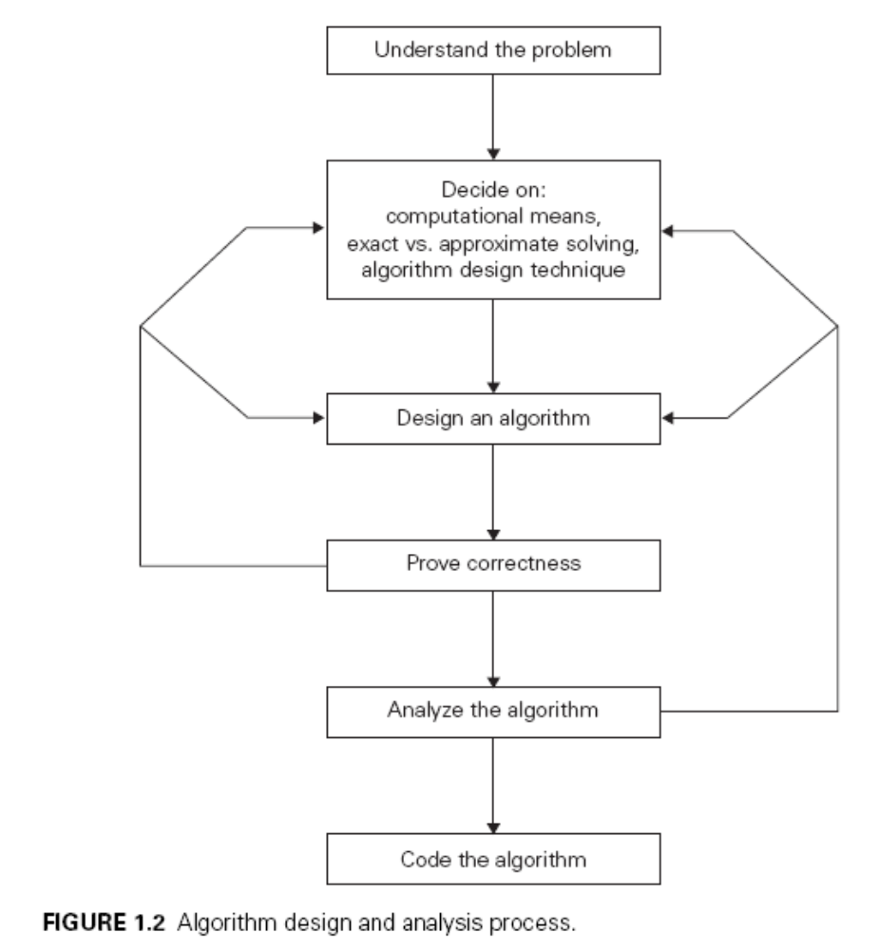
Design and Analysis of Algorithm

Slide 12
Algorithm design techniques/strategies
Brute force
Divide and conquer
Decrease and conquer
Transform and conquer
Space and time tradeoffs
Greedy approach
Dynamic programming
Iterative improvement
Backtracking
Branch and bound

Slide 13
Analysis of algorithms
How good is the algorithm?
  time efficiency
  space efficiency
Does there exist a better algorithm?
  lower bounds
  optimality

Slide 14
Important problem types
sorting
Two properties: stable and in-place
searching
string processing
graph problems
Traveling salesman problem, graph-coloring problem
combinatorial problems
Finding a combinatorial object that satisfies certain
constraints
geometric problems
Closest-pair problem, convex-hull problem
numerical problems
Example: solving equations, evaluating functions,
computing definite integrals and so on

Slide 15
Fundamental data structures
priority queue
HEAP
Graph
G = < V, E >
Representation:
Adjacency matrix
Adjacency list
Tree (connected acyclic
graph)
set and dictionary
list
  array
  linked list
  string
stack
LIFO
queue
FIFO

Slide 16
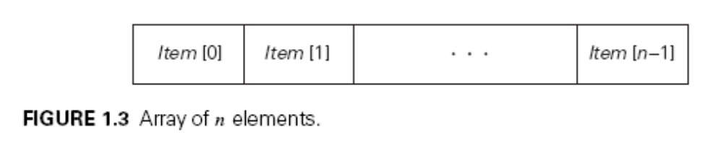
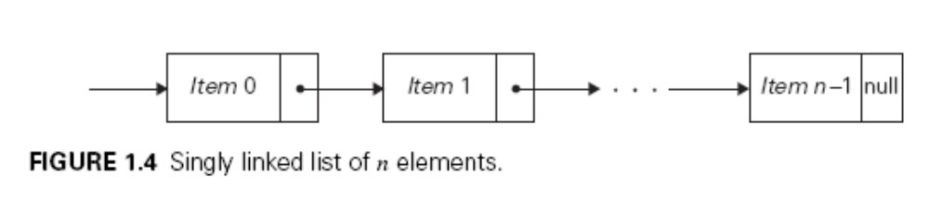
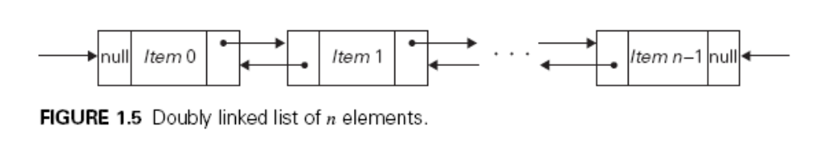

Slide 17
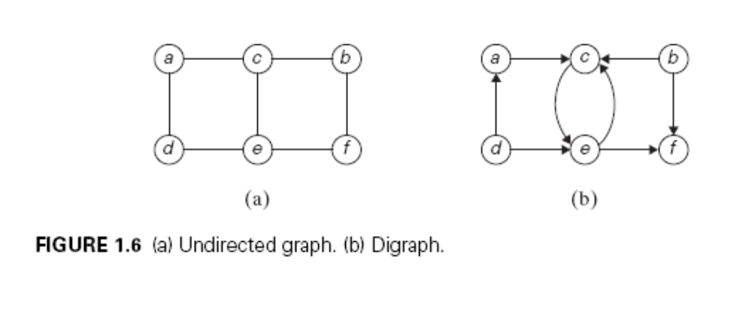
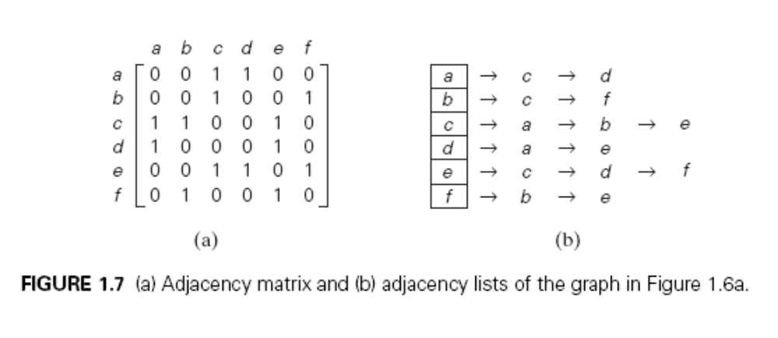
Levitin “Introduction to the Design & Analysis of Algorithms,” 3rd ed., Ch. 1 ©2012 Pearson Education, Inc. Upper Saddle River, NJ. All Rights Reserved.

Slide 18
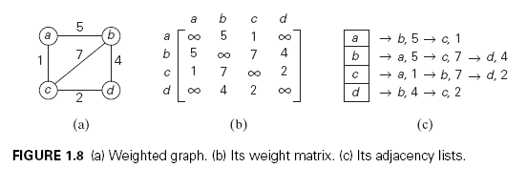
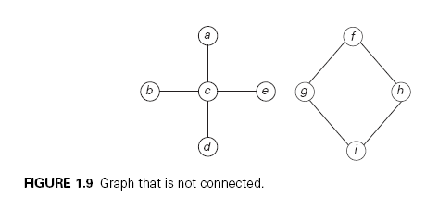

Slide 19
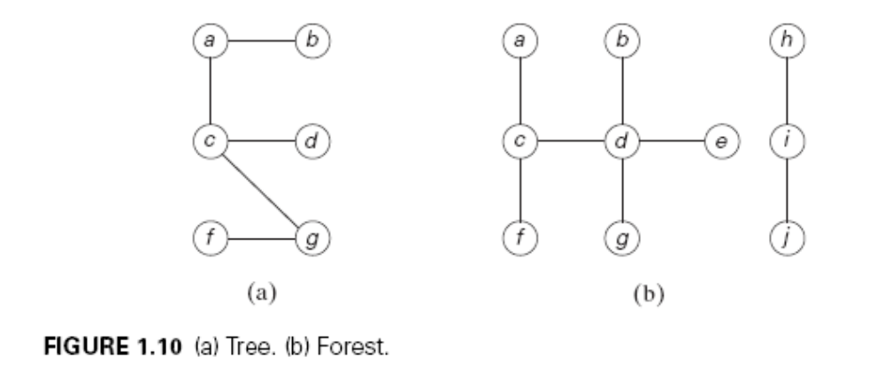
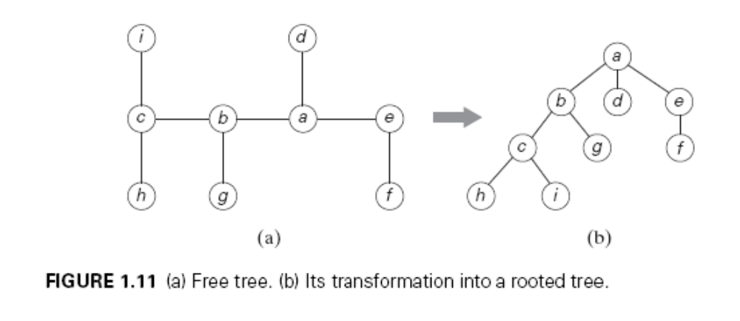
Levitin “Introduction to the Design & Analysis of Algorithms,” 3rd ed., Ch. 1 ©2012 Pearson Education, Inc. Upper Saddle River, NJ. All Rights Reserved.

Slide 20
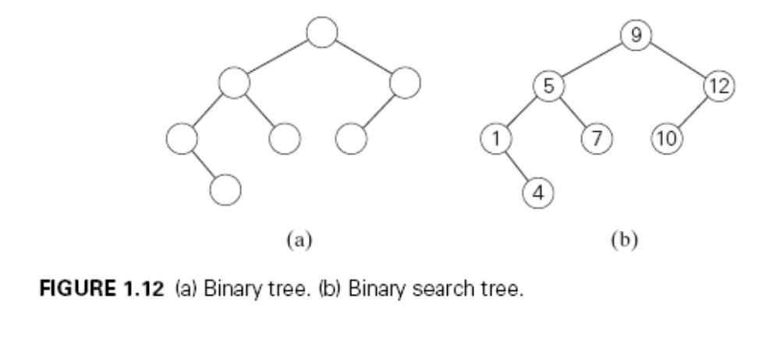
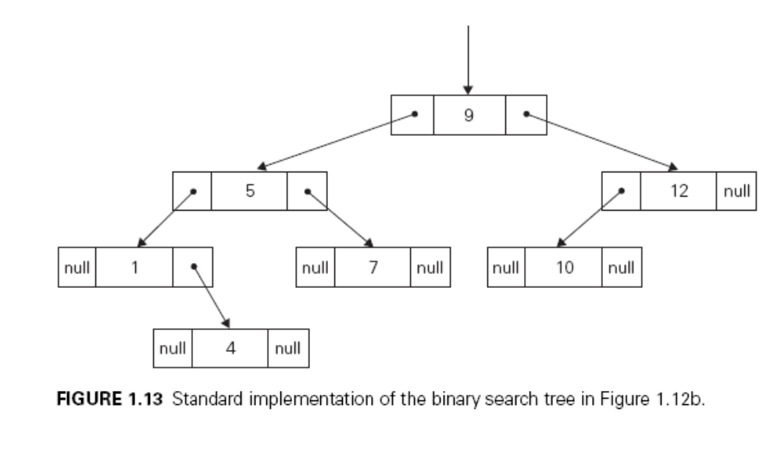
Levitin “Introduction to the Design & Analysis of Algorithms,” 3rd ed., Ch. 1 ©2012 Pearson Education, Inc. Upper Saddle River, NJ. All Rights Reserved.

